Slide 1
Age:
9–11
UNLOCK THE SECRETS OF THE INTERNET AND BECOME A DATA SUPERHERO!
Subject:
Computing, PSHE
Time:
Approx.
45–60 mins
THE INTERNET IS A VAST NETWORK – BUT WHAT DOES THAT REALLY MEAN?

Slide 2

CONTENT OVERVIEW
TEACHER NOTES
      Review this presentation and adapt it to meet your pupils' needs.
      Here is a suggested structure, if using the resource as a full lesson. You can also split up the activities over the course of several lessons.
ACTIVITY | OVERVIEW | SLIDES | TIMINGS
Starter activity | Draw the internet activity Introduce what the internet is and how it all connects Explore connected (and smart) devices Discuss of the role of the internet / how it is used Introduce the learning objectives and outcomes | 08–12 | Approx. 10 mins
Introduction: Superhero buildings | Frame how networks (LANs and WANs) work and store data through the growth of ‘Globix Corp’* Explore data centres and what makes them secure, including infrastructure and job roles A short ‘knowledge check’ quiz | 13–21 | Approx. 15 mins
Main activity: Data Superhero Challenge | Recap what a network is Introduce the parts of a data network Data Superhero Challenge – build a network diagram using the template | 22–28 | Approx. 15–20 mins
Plenary | Pupils reflect on their learning using the questions and / or emojis | 28–30 | Approx. 5–10 mins
Teacher slides won’t display in presentation mode.​
Student slides may have animations – view in presentation mode for full content.​
Slide notes include teacher guidance and sample answers.
*Globix Corp is an invented company for demonstrative purposes.

Slide 3
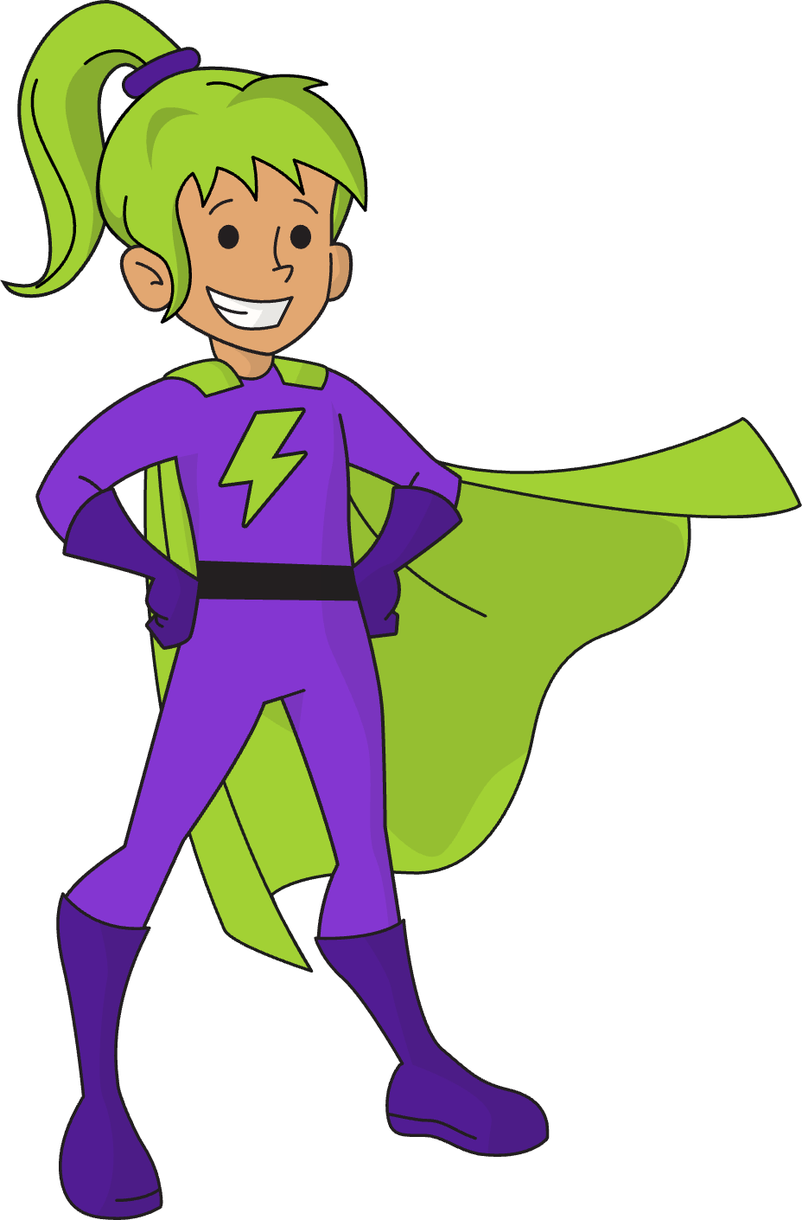
LEARNING OBJECTIVE AND CURRICULUM LINKS
TEACHER NOTES
      Learning objective:
      I can explain how computer networks, including the internet, offer services like the world wide web and support communication and collaboration.
      PSHE Association Programme
      of Study​ KS2 (9–11)
      L30. Students should learn about some of the skills that will help them in their future careers e.g. teamwork, communication
      and negotiation.
      England upper KS2 (9–11)​
      Computing: understand computer networks including the internet; how they can provide multiple services, such as the world wide web; and the opportunities they offer for communication and collaboration.​​
Who created this resource?
This resource was created by Kao Data in partnership with subject matter experts and teachers.​​
KAO Data operate high-performance data centres that store and process information for the internet and businesses.
https://kaodata.com

Slide 4

WORD BANK
Cable | Wires that carry data (or electricity) between different devices.
Collaboration | Working together with others to achieve a common goal, often using digital tools.
Client device | A computer, laptop, phone, tablet printer or scanner etc. that connects to a network.
Data | Information in digital form that can be stored, processed (used) and shared.
Data centre | A facility (place) used to house servers (powerful computers) used by organisations to remotely store, process or share large amounts of data.
Email | A way to send and receive (exchange) digital messages over the internet.
Internet | The worldwide network of computers and other client devices that communicate with one another.
LAN | Local Area Network: a network that connects devices and users in the same location, like a home or school.
Network | Two or more computers (or other client devices) connected to share data.
Router | Connects a LAN to the internet and acts as a hub or switch for local client devices, using cables and WiFi.
Server | A powerful computer that stores and shares data.
Switch | In a network, a switch makes sure the right data is sent between the server and each client.
WAN | Wide Area Network: a network that connects devices and users in different locations. The internet is the world's largest network.
WiFi | Wireless networking that uses radio waves instead of cables. WiFi stands for 'wireless fidelity’.
World Wide Web | A system of connected public webpages (documents linked by hypertext) accessed via the internet.
Notes:
Printable word bank to support pupils with new and / or complex key words covered in the lesson.

Slide 6
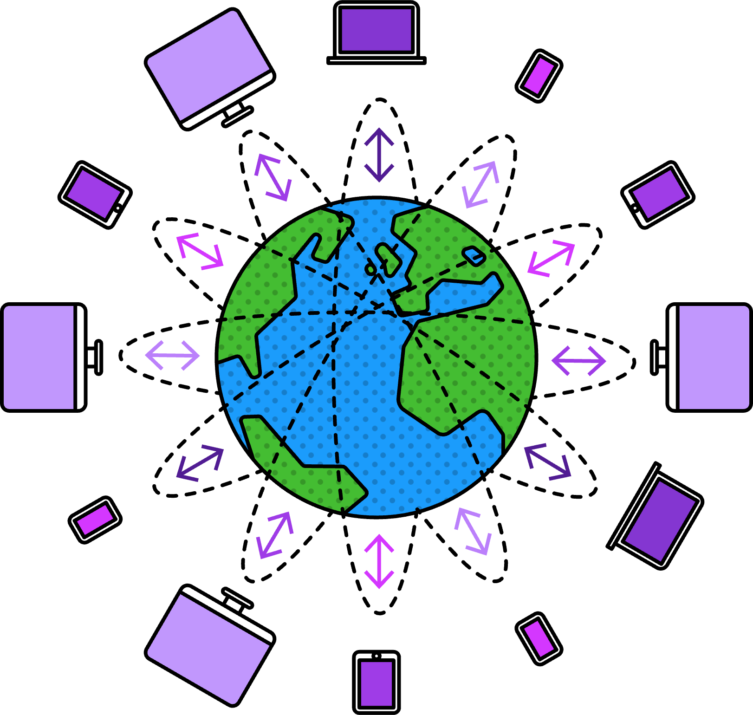


YOU HAVE ONE MINUTE TO DRAW THE INTERNET
We use the internet
every day, but many people don’t know what it is and how it works.
Today, you're going
to become a Data Superhero with all
the answers!
0
1
2
3
4
5
6
7
8
9
10
11
12
13
14
15
16
17
18
19
20
21
22
23
24
25
26
27
28
29
30
31
32
33
34
35
36
37
38
39
40
41
42
43
44
45
46
47
48
49
50
51
52
53
54
55
56
57
58
59
60
THINK ABOUT
What does it look like?
Where is it?
What happens when you search it?
CLICK TO START
Notes:
Starter activity | 4 slides | 8 minutes​
​
Introduce the three questions to think about before giving pupils exactly one minute to quickly draw what they think the internet looks like​.
After drawing, ask a few pupils to share their ideas with the class​.
Highlight that understanding the internet can be tricky, but they'll become "Data Superheroes" today!​
Additional support / alternatives:​
​
Allow pupils to write some key words down instead if drawing is too challenging​.
Prompt pupils to look at the word bank for inspiration if they are really stuck ​.
Challenge:​
​
Can pupils write down three words associated with the internet without looking at the word bank? Perhaps labels for their drawing?

Slide 7

WHAT IS THE INTERNET?
      The internet is a huge network that connects computers and devices all over the world. It’s made up of many smaller computer networks
      joined together.
      It lets us share data (information) between all the connected computers and devices!
DID YOU KNOW?
A network is a group of connected people or things, e.g. friends or co-workers, roads or train lines, nerves in your body – or computers.
Notes:
Starter activity | 4 slides | 8 minutes​
​
Other devices might include mobile phones or tablets (more examples will be introduced on the next slide).
Data is information. We need to store this information and send it from place to place.​
Ask pupils to share what they already know about how this data is stored and shared.​
​
Optional:​
​
Ask pupils to tell the person next to them what the internet is in their own words.

Slide 8

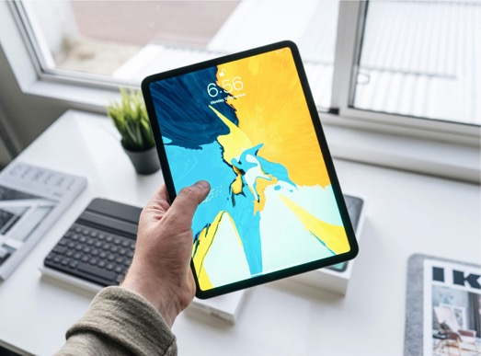
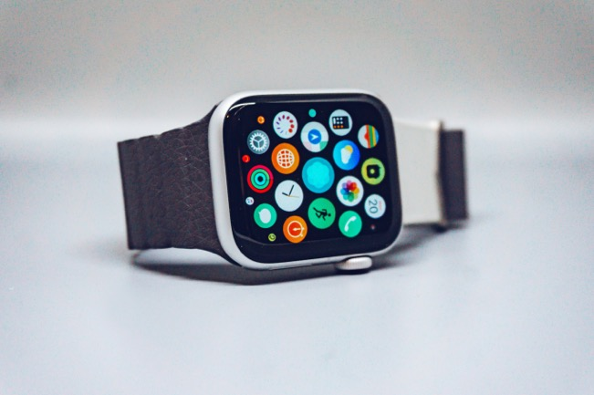
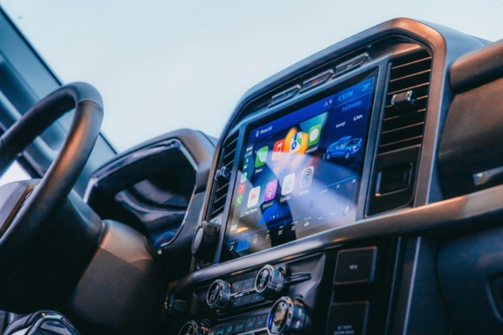
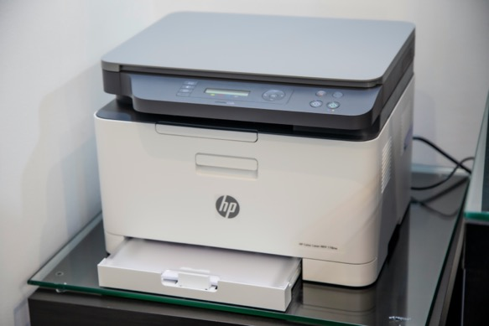
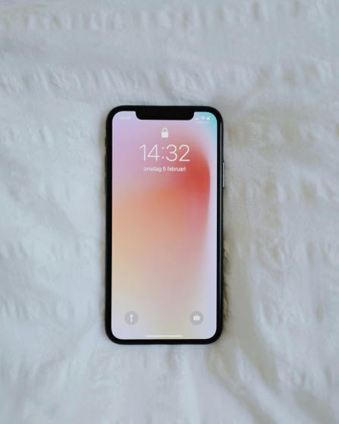
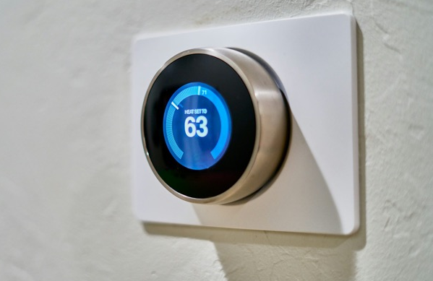
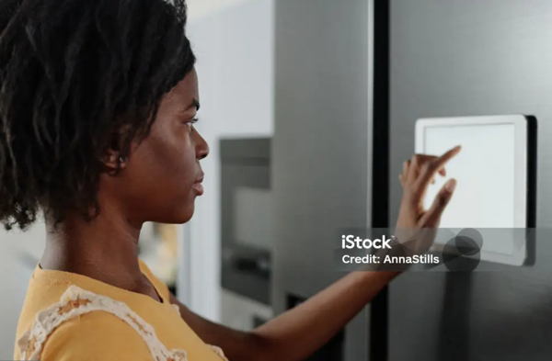
WHICH DEVICES CONNECT TO THE INTERNET?
DID YOU KNOW?
Any device connected
to the internet is called
a client.
Notes:
Starter activity | 4 slides | 8 minutes​
​
Ask pupils to use the images on the slide to give examples of which devices connect to the internet: laptops, tablets, phones, smart watches, modern cars, printers and heaters are connected by the internet. Can they give any more examples? E.g. speakers, video consoles, ring doorbell, Alexa​.
​
More and more devices are becoming 'smart devices' that can connect over the internet – this is sometimes called the Internet of Things (IoT). ​
​
An example is smart meters that help control the heating in our homes. These connected devices let you turn the heating on or off from far away, change the temperature, and even turn it off when no one is home. They can use motion sensors or GPS on your phone to check if anyone is in the house. ​
Another example is smart fridges monitor your food supply – they can send you a notification if you are running low on something like milk – or even add milk to your online shopping list!​
Extension: What data is being shared in each case?​
​
Laptops/Tablets/Phones: These devices share data that you create and data created by others – this might be messages, information, photos, videos, apps etc.​
Smart watches: They share health data like heart rate, steps, and sleep patterns to help track your fitness and give you health advice.​
Cars: Cars send data about where they are, how fast they’re going, and their engine status to help with navigation and maintenance.​
Smart fridges: They share information about what food is inside, when it’s going bad, and how cold it is to help with grocery shopping and keeping food fresh.​
Printers: Printers send data about what you’re printing, how much ink is left, and if there’s a problem with the machine to make sure everything works properly.
Photo credits
​
Phone – Photo by Oscar Nord on Unsplash - https://unsplash.com/photos/space-gray-iphone-6-on-white-textile-8l9VxXI28tY
Tablet – Photo by Henry Ascroft on Unsplash - https://unsplash.com/photos/person-holding-turned-on-black-ipad-7OFnb7NOvjw
Laptop – Photo by Glenn Carstens-Peters on Unsplash - https://unsplash.com/photos/person-using-macbook-pro-npxXWgQ33ZQ
Watch – Photo by Simon Daoudi on Unsplash - https://unsplash.com/photos/black-smart-watch-with-black-strap-2wFoa040m8g
Printer –Photo by Mahrous Houses on Unsplash - https://unsplash.com/photos/white-and-gray-hp-all-in-one-printer-5AoOejjRUrA
Car – Photo by Hans Isaacson on Unsplash - https://unsplash.com/photos/the-dashboard-of-a-vehicle-with-a-touch-screen-3sRFIUn-y28
Heating – Photo by Dan LeFebvre on Unsplash - https://unsplash.com/photos/gray-nest-thermostat-displaying-at-63-RFAHj4tI37Y

Slide 9
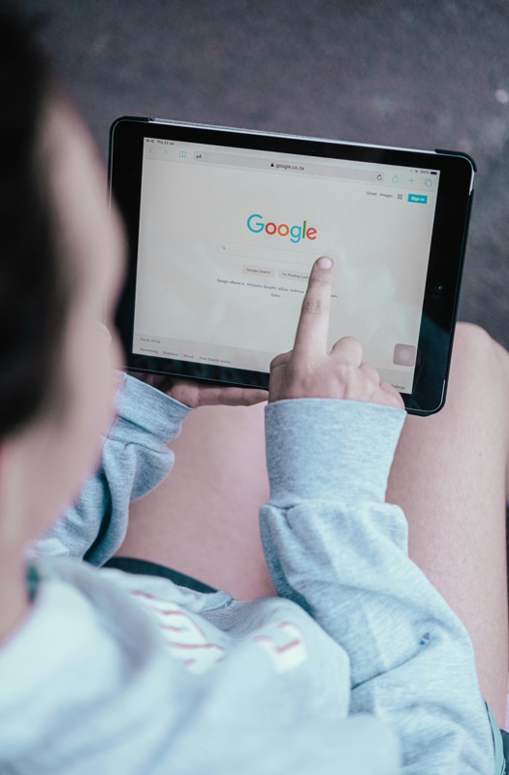
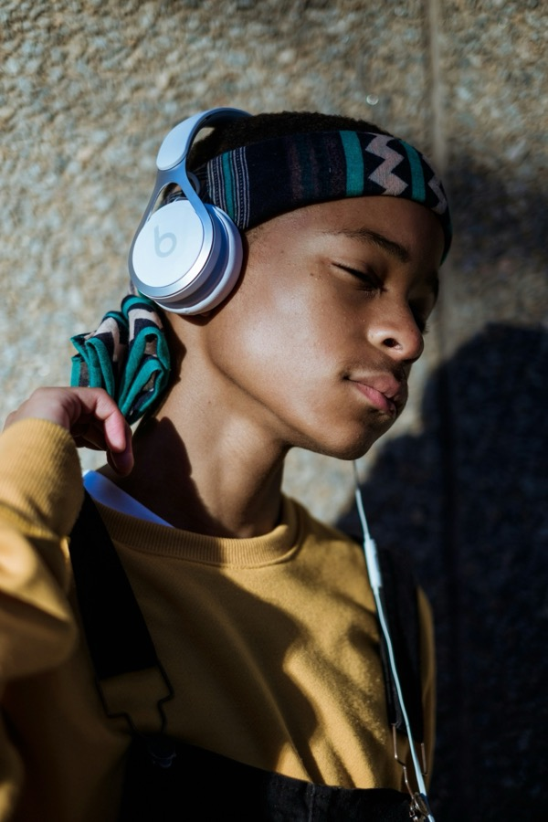
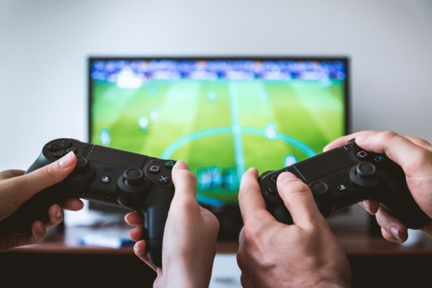
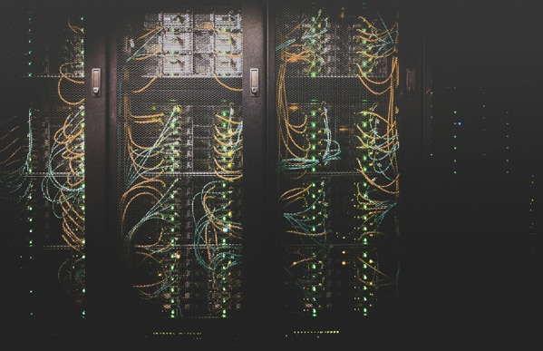
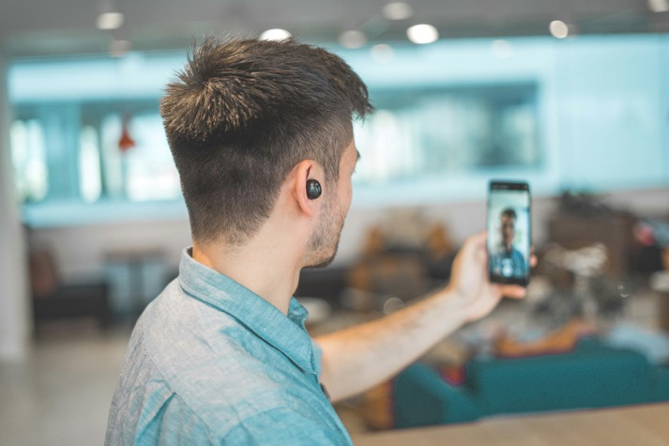
WHAT DO WE DO ON THE INTERNET?
Search for information and buy things
Enjoy music, TV and movies
DID YOU KNOW?
Search results, websites, messages, video, music and games are all types of data that can be shared on the internet.
Play games
Communicate with emails, messages, and audio and video calls
Store our data
Notes:
Starter activity | 4 slides | 8 minutes​
​
Using the photos as stimulus, ask pupils what someone a bit like them might do on the internet. Ask pupils to be general in their answers, rather than specific or personal.​
Click to reveal five common activities.​
​
Additional support / alternatives:​
​
Ask what each person might be doing.​
​
Challenge:​
​
Ask pupils to suggest what someone quite different to them might use the internet for, for example a teacher, a parent or grandparent. Identify differences and commonalities.​
​
Photo credits​
Photo by Duncan Meyer on Unsplash​
Photo by Hc Digital on Unsplash​
Photo by Mpumelelo Macu on Unsplash​
Photo by JESHOOTS.COM on Unsplash​
Photo by Taylor Vick on Unsplash ​

Slide 10
WHAT WILL WE LEARN TODAY?
      Learning objective​
      I can explain how computer networks, including the internet, offer services like the world wide web and support communication and collaboration (working together).
      Learning outcomes
      By the end of this lesson, I can:
      explain the communication and collaboration opportunities offered by networks
      explain how the internet provides services like the World
      Wide Web
      name and draw the parts of a network
DID YOU KNOW?
Binary is the number system that computers use to process and send data across networks.
Encryption is a way to keep data safe and private when it’s sent across networks.
      We need places to store data (data centres) and ways to simplify it (binary code) to send it from place to place (through a network) safely and securely (with encryption).
Notes:
Learning objectives | 1 slide | 2 minutes
Review the learning outcomes. Pupils will reflect on their progress and attainment at the end of the lesson

Slide 11
FIND OUT HOW THE INTERNET WORKS – GET READY TO TAKE ON THE DATA SUPERHERO CHALLENGE!

Slide 12

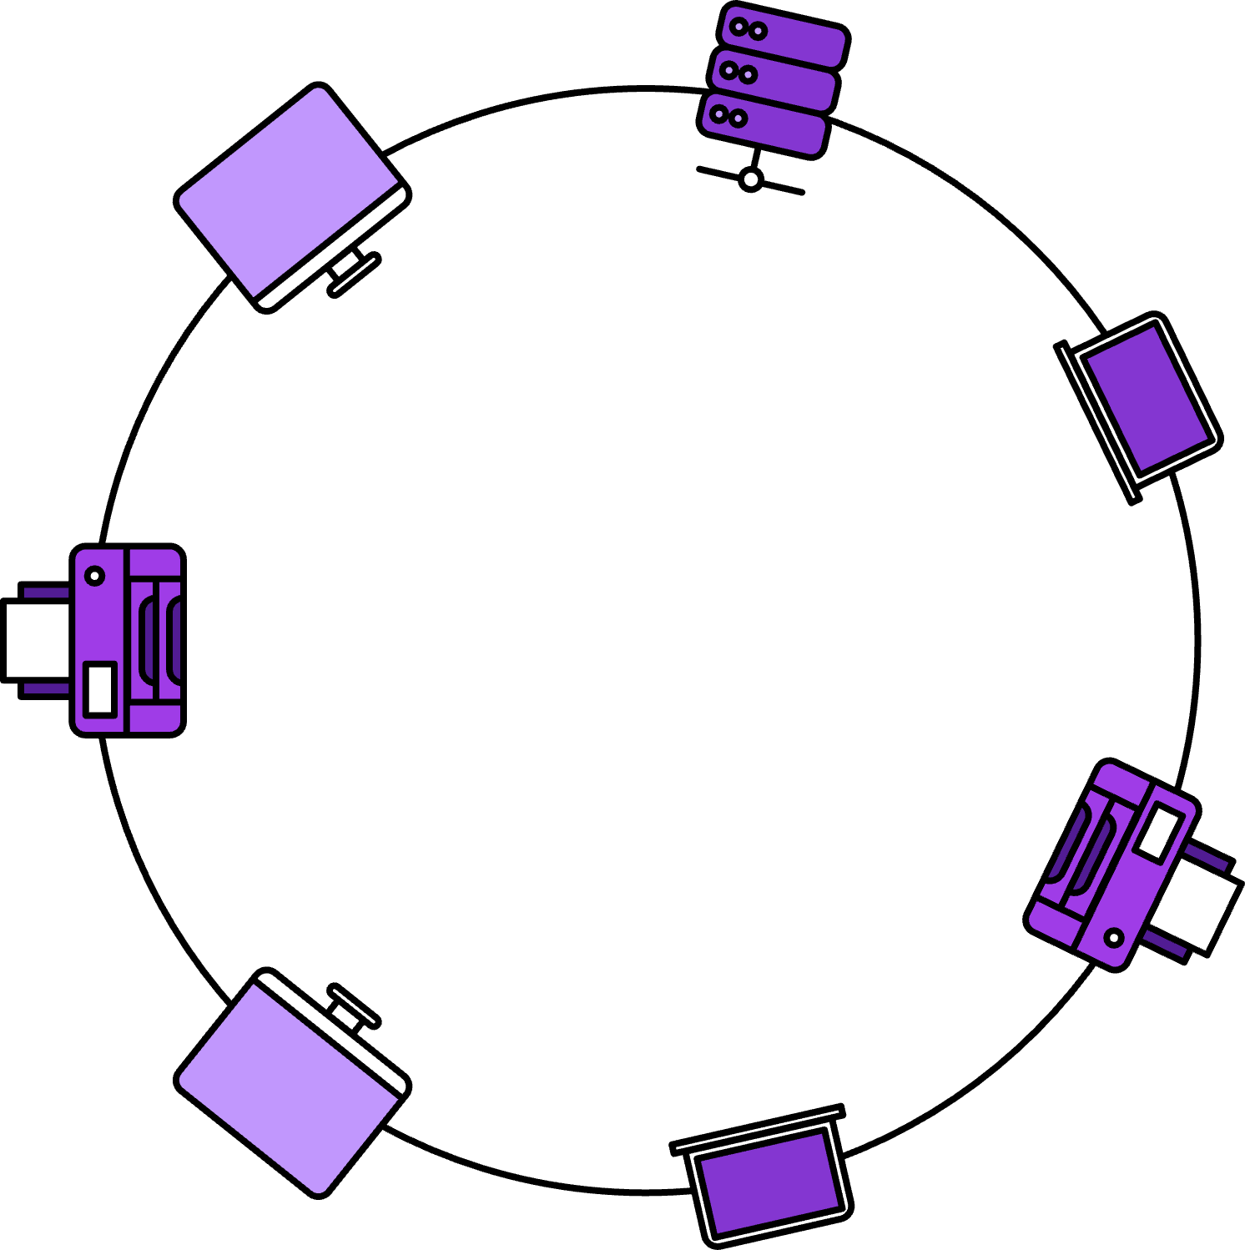
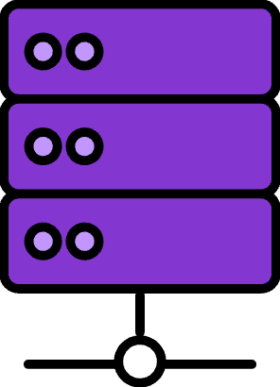
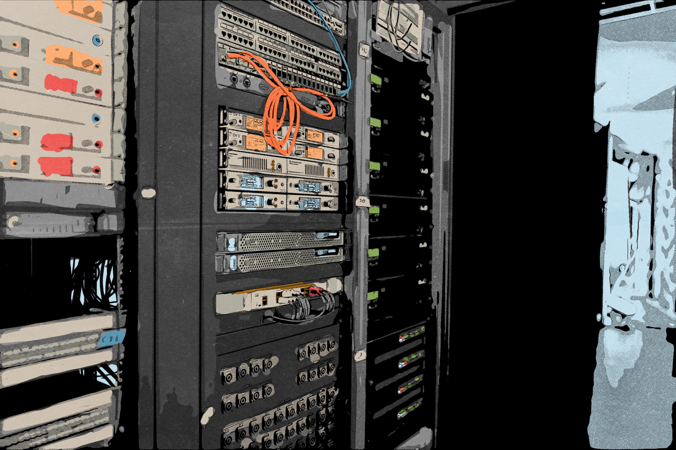

WELCOME TO GLOBIX CORP
      A server is a powerful computer that stores and shares everything created by the employees.
      In the Manchester office, 1,000 employees create emails, slides and spreadsheets that can
      be opened on any of
      their laptops. They can print them on 25
      shared printers.
      This works because everything is connected by a Local Area Network (LAN) like this one.
      Office servers are
      stored in locked, cold rooms – why?
      Server
Notes:
Superhero buildings | 8 slides | 15 minutes​
​
Introduce the concept of a Local Area Network (LAN) using the ‘Globix Corp’ example. ​
Explain that some computer networks have a server – a powerful computer that stores and shares everything created by the employees. ​
Point out that using a server is better than storing things on your device (locally) – no one else could see it and you’re less likely to run out of space. ​
Ask pupils why they think office servers are kept in locked, cold rooms. Possible answers: need to prevent the servers from overheating and potentially breaking, locked because they can have highly sensitive / secretive information on them, so it needs to be a very secure room.​
Challenge: ​What are the potential problems if a server fails in an office? ​Possible answers: ​
​
losing access to documents, emails etc. ​
network printers could also stop working​
work would have to stop whilst it is resolved, which costs a company lots of money ​
could lose all data (all their work) if it isn’t properly backed up elsewhere too.

Slide 13

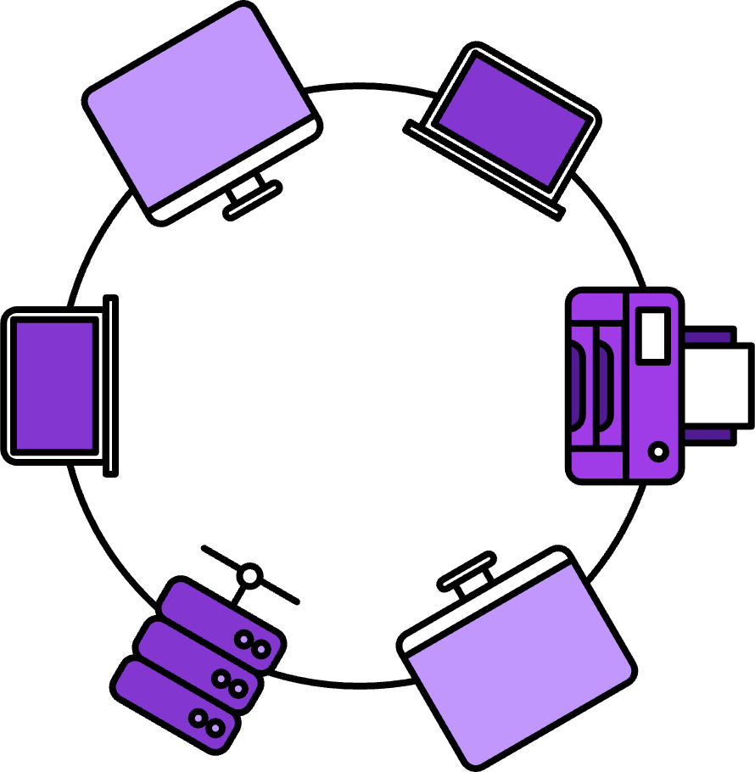
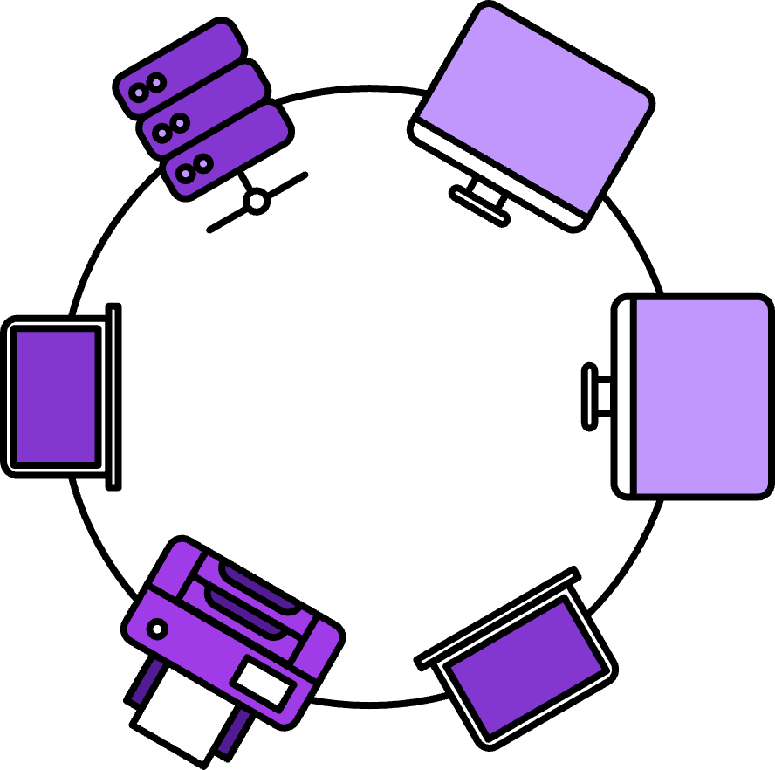
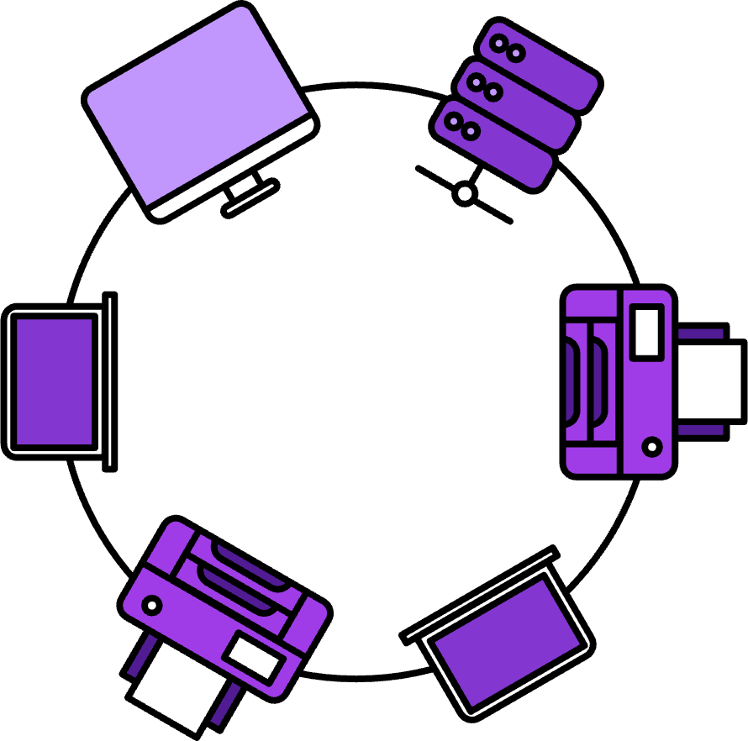
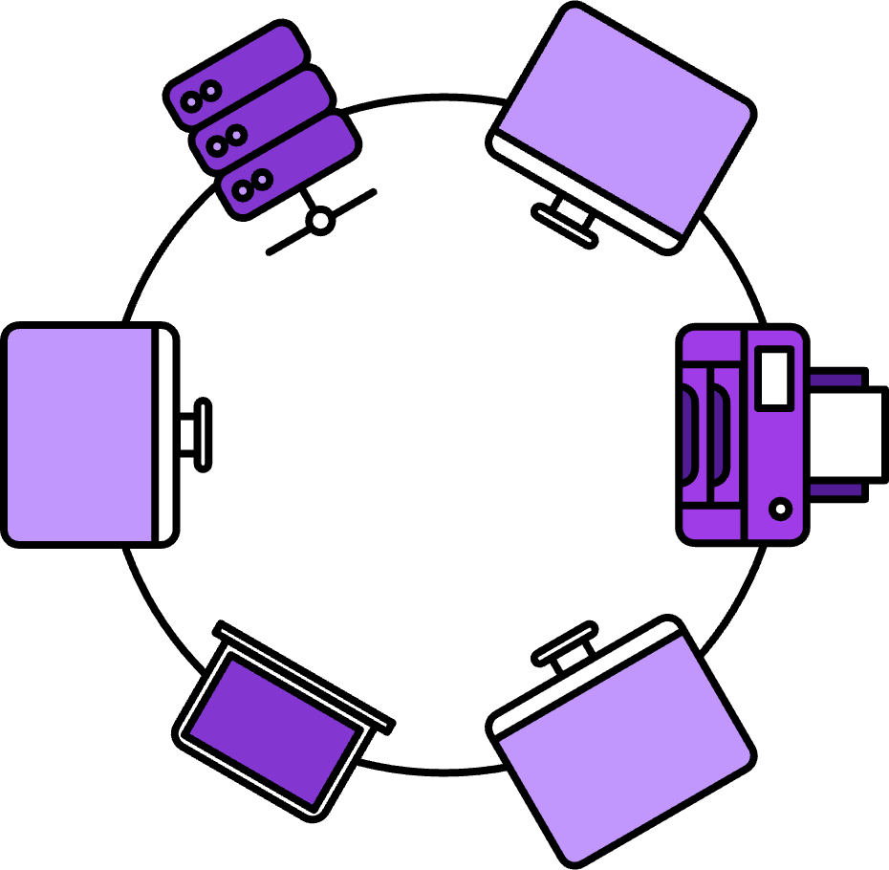
GLOBIX CORP
HAS GROWN!
      The company now has four offices, and everyone needs to open each other's documents.
      Peterborough
      Glasgow
      They can do this because the four LANs are connected in a Wide Area Network (WAN)
      Cardiff
      Belfast
      Networks help all Globix Corp's employees to communicate and collaborate!
Notes:
Superhero buildings | 8 slides | 15 minutes
Use the company expansion to introduce Wide Area Networks (WANs) as multiple LANs connected over distance.
Emphasise how networks enable communication and collaboration across locations (in a country and across the world!)
Ask pupils to think about why a company would need a WAN (sharing resources, collaborating via online meetings etc).
Ensure pupils understand the difference between a LAN and a WAN.
Support:
Compare to familiar concepts: LAN is like talking to people in the same room; WAN is like phoning someone in another city.

Slide 14
CONNECTING GLOBIX
CORP AND THE WORLD
      Globix Corp employees don’t
      just look at files created by
      their colleagues!
      They also visit websites and share documents with other companies.
      They can do this because the Globix Corp network connects to millions of other networks around the world – that's the internet!
DID YOU KNOW?
The world wide web is a collection of webpages found on the internet (a global network of computers). Your web browser uses the internet to access the world wide web.
Notes:
Superhero buildings | 8 slides | 15 minutes
The internet is a massive WAN!
Explain that the company network connects to the global internet so they can share things with other companies.
Clarify the difference between the internet (the network), the world wide web (websites) and the web browser (uses the internet to access the world wide web).
Everything you look at on the internet is stored on a computer or server somewhere – and a lot of this data is stored at data centres!

Slide 15

GLOBIX CORP
HAS A WEBSITE
      Like most websites, globixcorp.com is
      stored on a server at
      a data centre!
DID YOU KNOW?
If something is stored 'in the cloud,' it is stored in a server at a data centre so you can access it from any device.
Notes:
Superhero buildings | 8 slides | 15 minutes​
​
Explain that instead of having the servers in their offices, some companies pay to use servers in a data centre. ​
Globix Corp store its website, files and other information on servers in a data centre rather than in their own office.​
Ask pupils why it could be better to store data at a data centre rather than on a local device?​
Possible answers: ​
​
better security​
reliability​
efficiency (especially by having it all in one place)​
sometimes companies are remote, with everyone working from home and they do not have an office. ​
backup power if there is a power cut​
data isn’t lost if the computer / laptop breaks​
more storage space​
​
Did you know?​
Talk through the ‘did you know?’ box with pupils and that personal devices such as phones give us the opportunity to save to the cloud. ​
Ask pupils: If someone has lots of photos on their phone, what is the advantage of saving them to the cloud? E.g. stops them from running out of space on their phone; if the phone breaks, the photos won’t be lost; very secure unless you specifically give someone access etc.

Slide 16
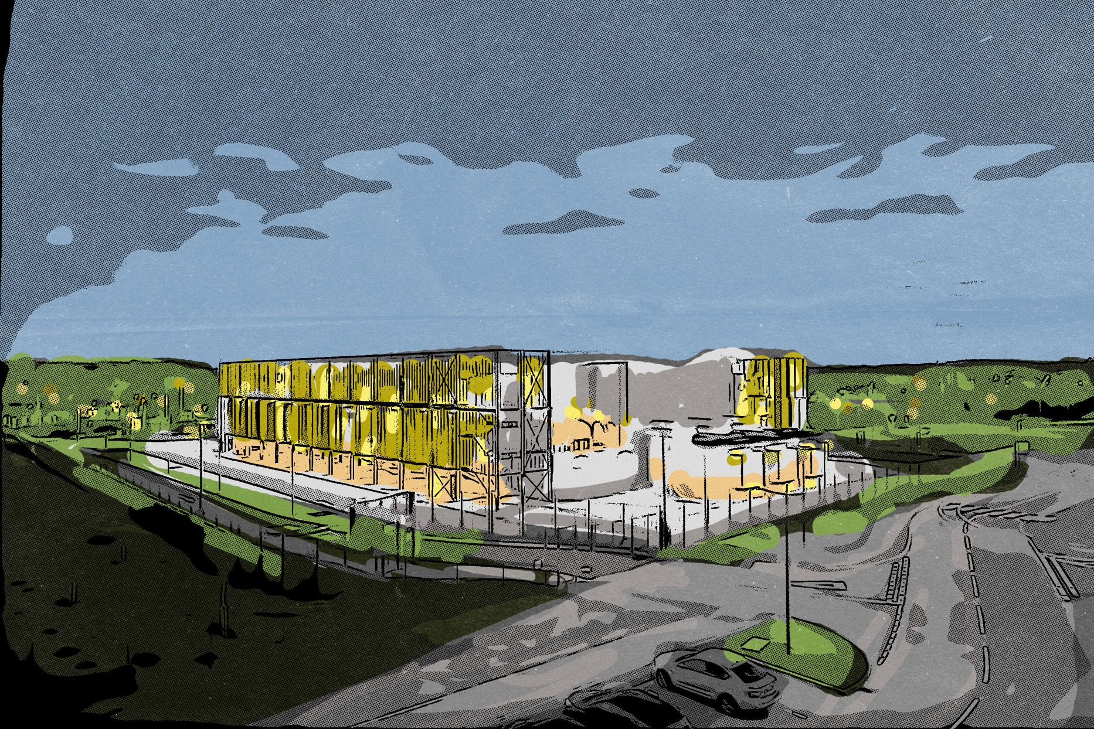
SUPERHERO BUILDINGS…
      Data centres are enormous buildings filled with powerful servers that store and process data for websites, apps and cloud services – they keep the internet working!
Notes:
Superhero buildings | 8 slides | 15 minutes​
​
Reinforce that a data centre is an enormous building filled with lots of powerful servers to store and process data. Without them we couldn’t use the internet!

Slide 17
SUPERHERO BUILDINGS…
      Other than servers, what's inside?
      Data centres need a lot of energy to store, process and share data, as well as keeping their servers cool, so they are working to become more eco-friendly.
      Backup power – to keep everything running during power cuts.
      Computer equipment to manage internet traffic and security.
      Biometric scanners, cameras, and guards
      to protect sensitive data.
      Cooling systems
      – to prevent servers
      from overheating.
Notes:
Superhero buildings | 8 slides | 15 minutes​
​
Talk through what else, other than servers, is inside a data centre. ​
One of these is security equipment, like biometric scanners, cameras etc. Ask pupils what they think ’biometric’ means? Answer: a way to verify someone's identify using features like fingerprints, face recognition or eye recognition​.
Challenge:​
​
Data centres are becoming more eco-friendly. Thinking about recent advancements in sustainability, how can data centres save or reuse energy?

Slide 18

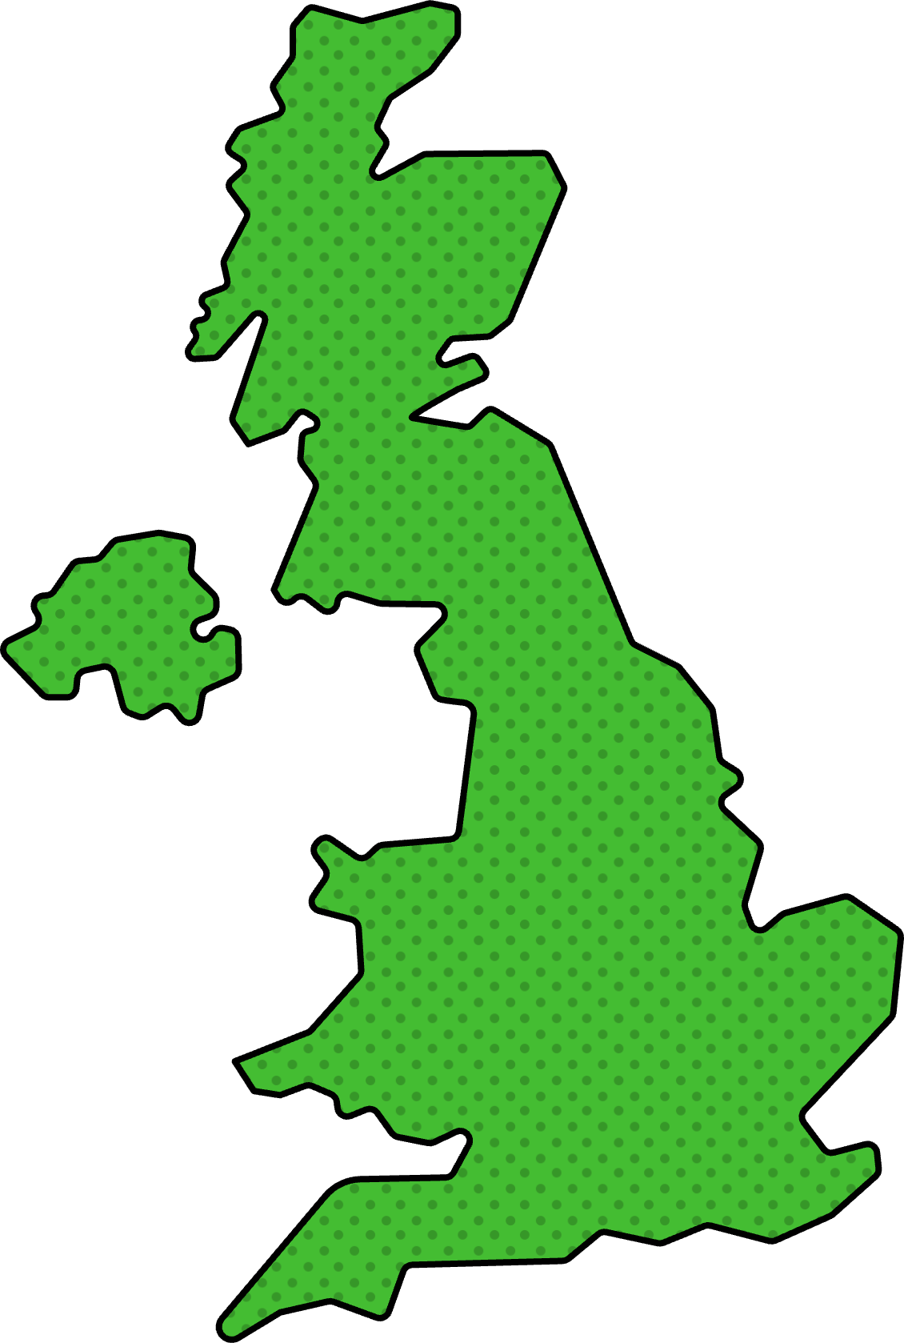
SUPERHERO BUILDINGS…
Kao Data has four data centres:
      Slough
      Stockport
      Harlow
      Northolt
Notes:
Superhero buildings | 8 slides | 15 minutes​
​
KAO Data has four data centres in the UK.​

Slide 19
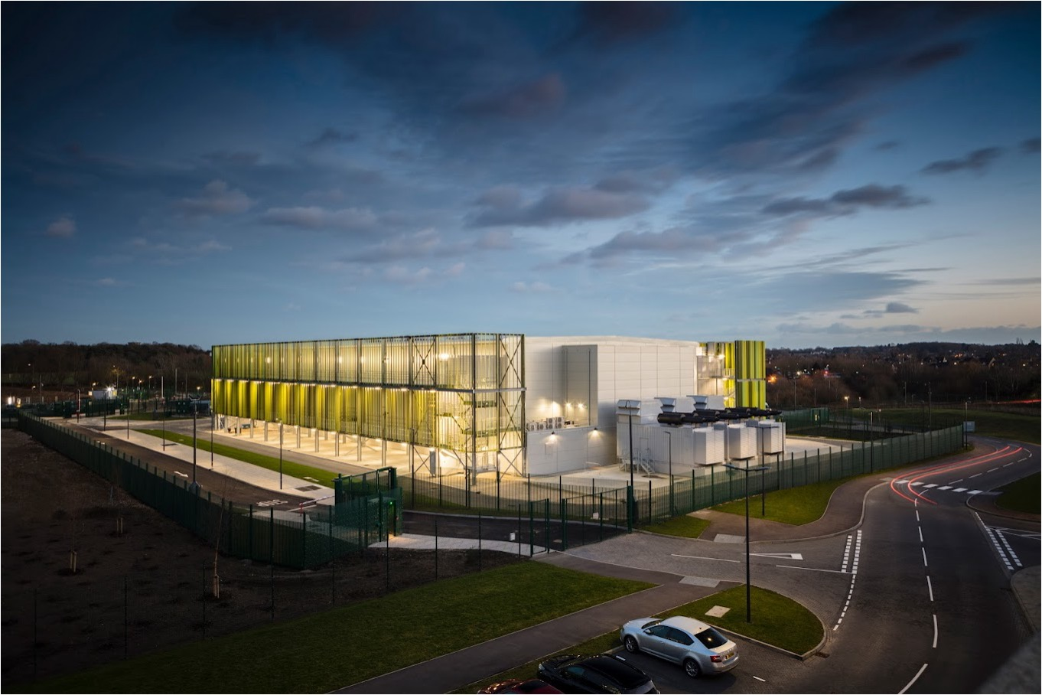

...RUN BY DATA SUPERHEROES!
Notes:
Superhero buildings | 8 slides | 15 minutes
Explain to pupils that we have looked at what is inside a data centre that makes it special; they are now going to see what other features make it a superhero building e.g. the people who work there!
Play the video (https://player.vimeo.com/video/1108027976?h=293156b4e7&badge=0&autopause=0&player_id=0&app_id=58479) to find out more about the careers that keep the internet running, because without humans, technology wouldn’t even have been created and developed!
Optional:
Ask pupils to write down as many different careers as possible they hear in the video.

Slide 20
QUIZ TIME
      Q1: D _ _ _ is information that is stored, processed and shared by computers and servers.
      Q5: A s _ _ _ _ _ is a powerful computer that stores and shares information for other computers to access.
      Q2: A W_ _ _ A _ _ _ N _ _ _ _ _ _
      is a network that connects multiple LANs over a large area, like different cities or countries.
      Q6: Servers are often stored in locked cold rooms to prevent them from o _ _ _ _ _ _ _ _ _ _.
      Q3: L _ _ _ _ A _ _ _ N _ _ _ _ _ _
      connects computers and client devices within a small area, like an office or home.
      Q7: The W _ _ _ _ W _ _ _ W _ _ is a collection of webpages found on the internet.
      Q4: The internet is a massive LAN/WAN. (Choose the right answer)
      Q8: A d _ _ _ c _ _ _ _ _ is a large building filled with servers that store and process data.
Notes:
Superhero buildings | 8 slides | 15 minutes
Either as a whole class, in pairs to feed back to the class or on mini whiteboards, test how confident pupils feel about what they have learnt so far in the lesson.
This can help inform about the level of support pupils may need in the following ‘Data Superhero challenge’.

Slide 21
BUILD A DATA NETWORK

Slide 22


NETWORKS RECAP
      A network is two or more computers connected together.
      A network allows us to:
      Store information on one computer and access it from another.
      Connect and share other clients like printers and data storage.
Notes:
Data Superhero challenge: Build a data network | 4 slides | 15–20 minutes
Review the concept of a network. For example, each pupil in the class has a network that includes everyone they know: friends, teachers, neighbours and family members – some of these people live in the same place or close by like how a building might contain many connected computers. This is called a local area network, or LAN.
Remind pupils that some of these people might live a long way away, perhaps even in another country, like how computers are connected across different buildings, of even the entire internet. – can they remember the name of this type of network? Answer: this is a wide area network, or WAN.
If the quiz showed pupils need extra support:
Review what a network allows us to do: share resources such as printers, access and share files, make video calls, send emails, access files on multiple devices, back up data, get updated security and software easily.

Slide 23
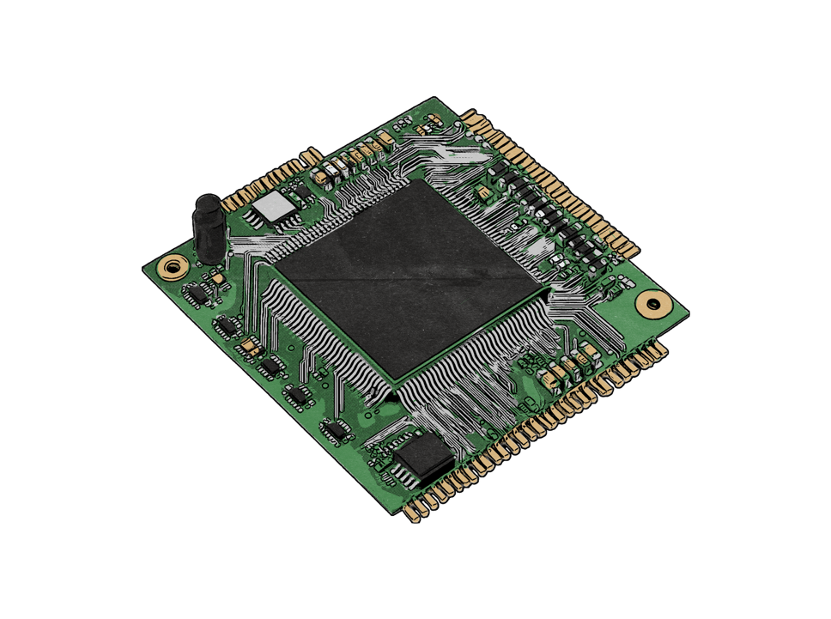
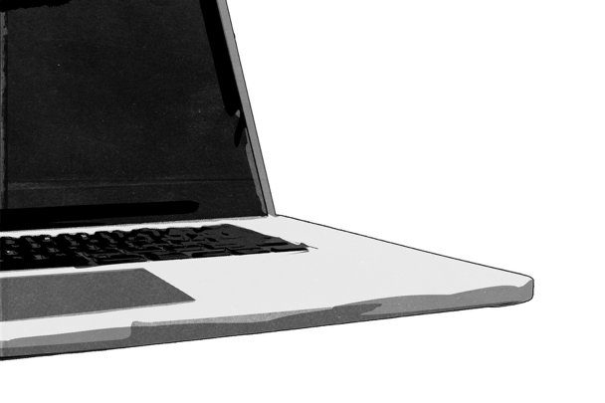
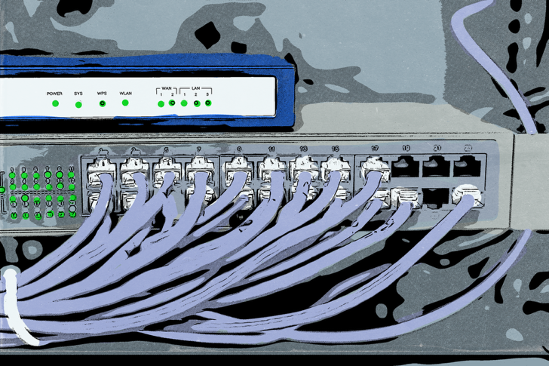
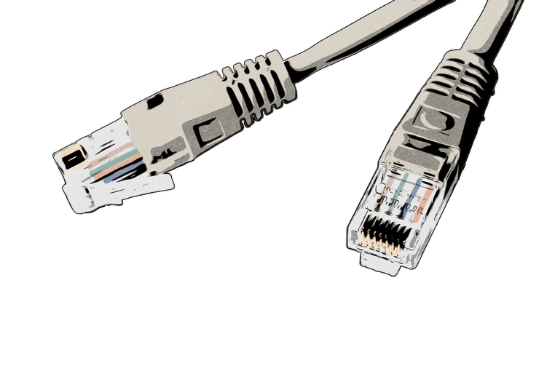
PARTS OF A DATA NETWORK
      Clients are devices like computers or phones that connect to a network.
Every server switch and client has a unique identifying number called a MAC address.
Switches use MAC addresses to send data to the correct server
or client.
      A server is a powerful computer that stores data.
      Switches make sure the right data is sent between the server and each client.
      Your internet router at home includes a switch.
      Data travels through WiFi or data cables.
Notes:
Data Superhero challenge: Build a data network | 4 slides | 15–20 minutes
​
Ask pupils, whilst the answers are hidden, if they can name some of the equipment needed to form a network.​
Click to reveal answers: servers, switches and clients, then click to reveal MAC addresses. ​
Think back to the analogy of a human network, a MAC address is like your own name and address, that ensures post gets to the right person in the right home. To get data from a server to the person who asks for it, the MAC address of the server, switch, home router and device are all needed as part of the 'address' to send this data.​
​
Big misconception! Tell pupils that the MAC address refers to the unique identifying number on the server switch and client; it is completely separate from Apple Macs, which is a computer brand!​
​
Finally, click to reveal cables and WiFi – which are how data travels through the network (the ‘roads’ between houses in the network in our postal analogy).

Slide 24






SUPERHERO CHALLENGE: BUILD A DATA NETWORK
      Your labelled drawing should connect:
      Three servers in a
      data centre.
      One switch in Alice's home (inside the router).
      Alice has clicked on a link on her phone to open a website. The website is stored in a data centre in Manchester.
      Draw and label a WAN that shows how Alice's home connects to the data centre.
      One switch at the
      data centre.
      Four clients in Alice's home: a laptop, two phones and a smart TV.
Hint!
Think about whether each part will connect using
Cables –––– or WiFi – – –
Notes:
Data Superhero challenge: Build a data network | 4 slides | 15–20 minutes
Pupils each need a copy of the 'Build a data network' activity template, scissors and glue sticks.​
​
Pupils are going to create their own WAN that links a data centre to Alice’s home, drawing and labelling a diagram.​
Review what equipment the WAN needs to include.​
Give pupils time to create their WAN. Project this slide as they complete the task.
Support:
Give pupils the option to just label and add the connections their network.
Challenge:
Using what they have learned this lesson so far, write a short sentence next to as many of the components as possible to explain what they are / do e.g. cable > data travels through it.

Slide 25





TEMPLATE
      Use this the picture bank to build your data network. Remember to add connections!
      Data centre
      Alice’s house
      Picture
      bank:
      Cable
      WiFi
      Server
      Switch
      Router switch
      Laptop
      Mobile
      Smart TV
Notes:
Printable worksheetv

Slide 26
TEMPLATE
      Label the diagram and add the connections to build your data network.
      Data centre
      Alice’s house
      Word bank:
      Clients
      Router
      Server
      Switch
      Connections:
      Cable
      WiFi
Notes:
Printable worksheetv

Slide 27






SUPERHERO CHALLENGE: HOW DID YOU DO?
      Data centre
      Alice’s house
      Three servers
      Switch
      Home router (with switch inside)
      Clients
Notes:
Data Superhero challenge: Build a data network | 4 slides | 15–20 minutes
Share this example of a complete network – how similar were their own creations?
Run through the reasons for the way the data network is set up on the example above:
The servers in the data centre all connect to the switch by cable.
Cables connect data centres to each home.
In the home, a router acts as a switch to send data to the right client device.
Each device connects via WiFi (the laptop and TV box might instead connect using cables).
Challenge:
Ask what happens when a pupil takes their phone to a friend's house, and it asks to connect to the network. Answer: the phone is given a new MAC address by the friend's router, so that it can connect to the internet and receive data.

Slide 29





CONGRATULATIONS,
DATA SUPERHEROES!
      Now you know a lot more about the internet and how it works!
      How confidently can you:
      explain the communication and collaboration opportunities offered by networks
      explain how the internet provides services like the World Wide Web
      name and draw the parts of
      a network.
      1
      2
      3
      4
      5
If you were doing your drawing of the internet again, would it be different? How?
Notes:
Plenary | 3 slides | 5–10 minutes
Pupils can rate how confident they feel against the learning outcomes using emojis or the pupil’s / teacher's preferred approach e.g. scale of 1–5, three emotions, knowledge confidence box etc.
Ask pupils to look back at their drawing from the beginning of the lesson, in what way would their drawing be different if they did it again, now they have become data superheroes?
Extension
If there is time leftover, pupils may re-draw the internet with their new knowledge!

Slide 30
TAKE THE DATA SUPERHERO CHALLENGES!
kaoacademy.kaodata.com
Notes:
Plenary | 3 slides | 5–10 minutes
Get pupils excited with what is to come next!

